Slide 1
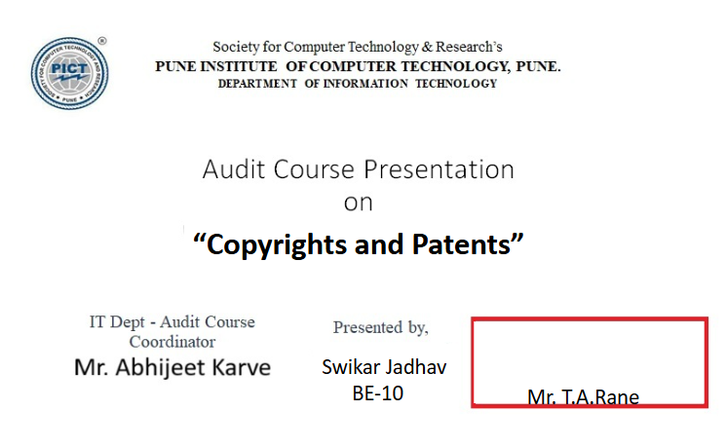
Rajvardhan Deshmukh
BE 10
Mr. Manish Khodaskar

